Slide 1
101學年度「科技藝術專題講座」心得報告
數位藝術與我們的未來:
對2012年奧地利電子藝術節的觀察
Digital Art vs Our Future:
Observation of 2012 Ars Electronica
演講者: 孔繁芸
科技藝術專題講座
期末報告呈現:
游惠喻
李盈賢

Slide 2
關於演講者 孔繁芸
現任 資策會數位教育研究所 所長
擔任「網路多媒體—核心關鍵人才培訓計劃」研習活動的規劃與
執行
經歷 台視文化製作部 執行製作
資策會數位教育研究所 副工程師
BACKGROUND

Slide 3
演題大綱
ARS ELECTRONICA FESTIVAL 背景
ARS ELECTRONICA FESTIVAL 2012 活動摘要
觀察與心得
SUMMARY

Slide 4
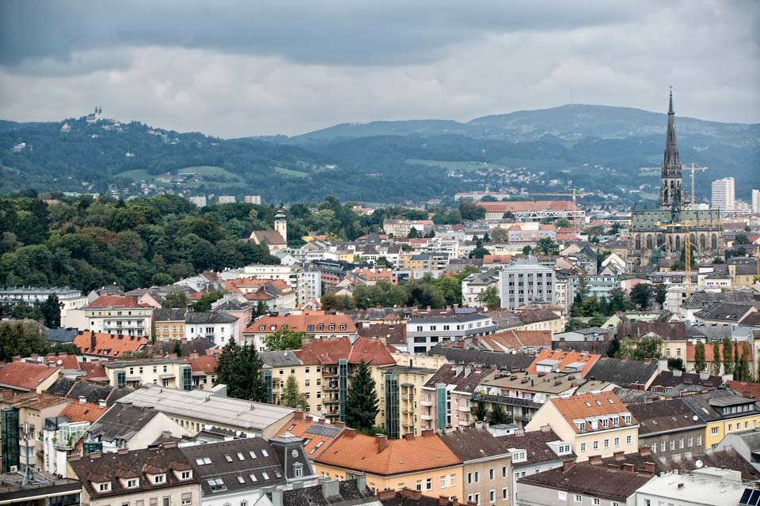
ARS ELECTRONICA 奧地利電子藝術節
Since 1979
Austria Linz - 鋼鐵工業城
BACKGROUND

Slide 5
ARS ELECTRONICA 奧地利電子藝術節
Prix Ars Electronica
Computer Animation/Film/VFX
Interactive Art
Digital Music
Hybrid Art
Digital Communities
U19
Art and Technology Grant
BACKGROUND

Slide 6
ARS ELECTRONICA 奧地利電子藝術節
Theme
2011 Origin－How It All Begins
2010 REPAIR － ready to pull the life line
2009 Human Nature － The Reinvention of Nature
2008 A NEW CULTURAL ECONOMY － The Limits of Intellectual Property
2007 GOODBYE PRIVACY － Welcome to the Brave New
2006 SIMPLICITY － the art of complexity
2005 HYBRID － Living in a paradox
BACKGROUND

Slide 7
ARS ELECTRONICA 2012 奧地利電子藝術節
WHY THE BIG PICTURE ？
BACKGROUND

Slide 8
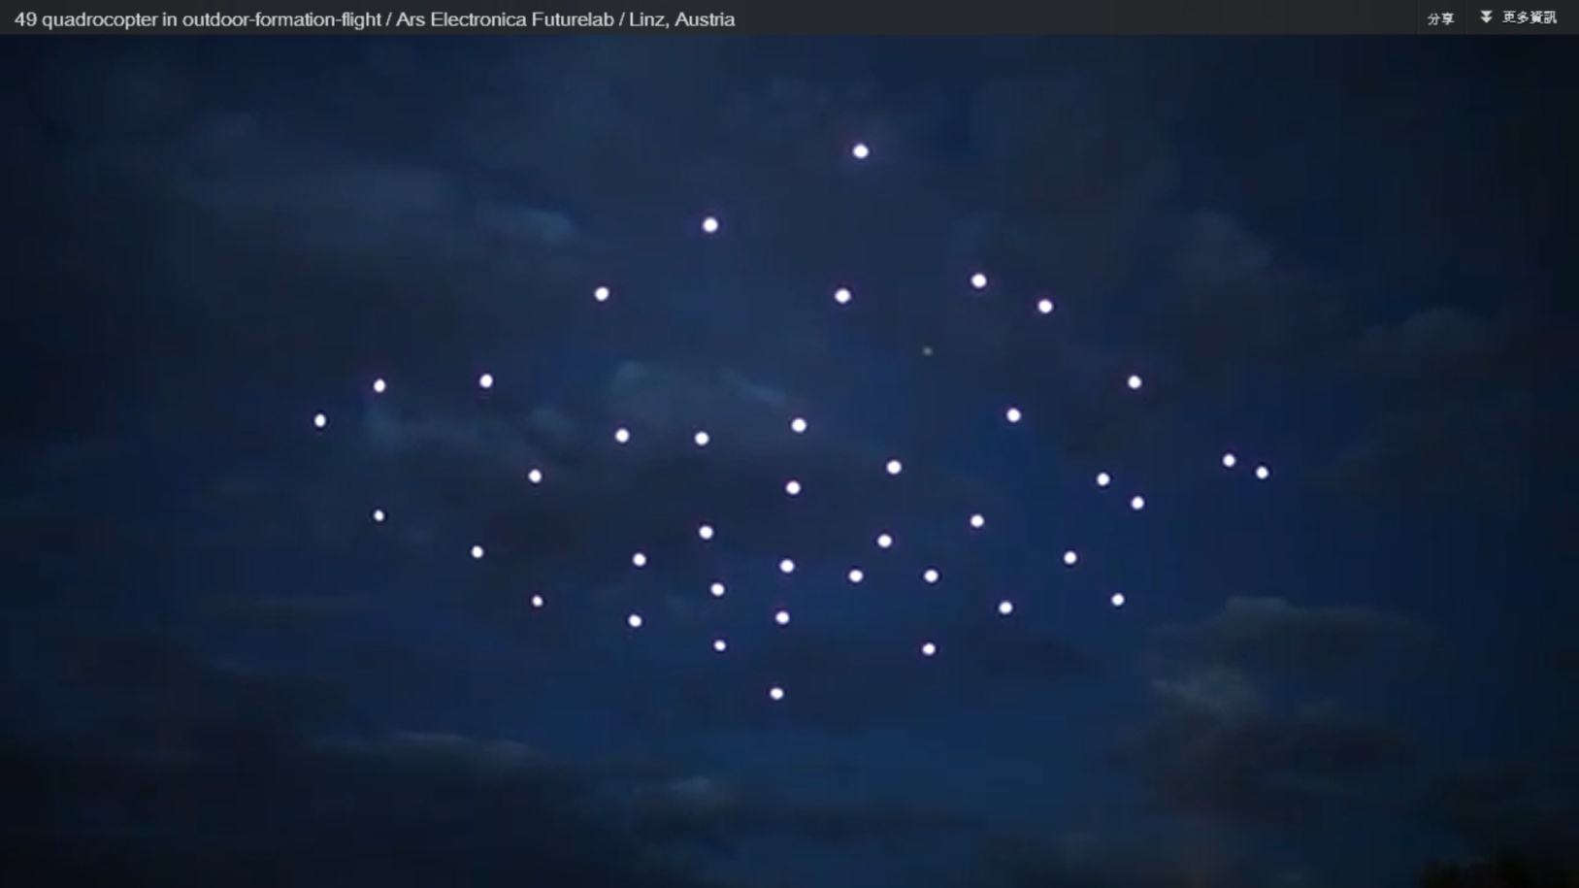
ARS ELECTRONICA 2012 奧地利電子藝術節
THE OPEN CLOUD PROJECT – The opening of THE BIG PICTURE
BACKGROUND

Slide 9
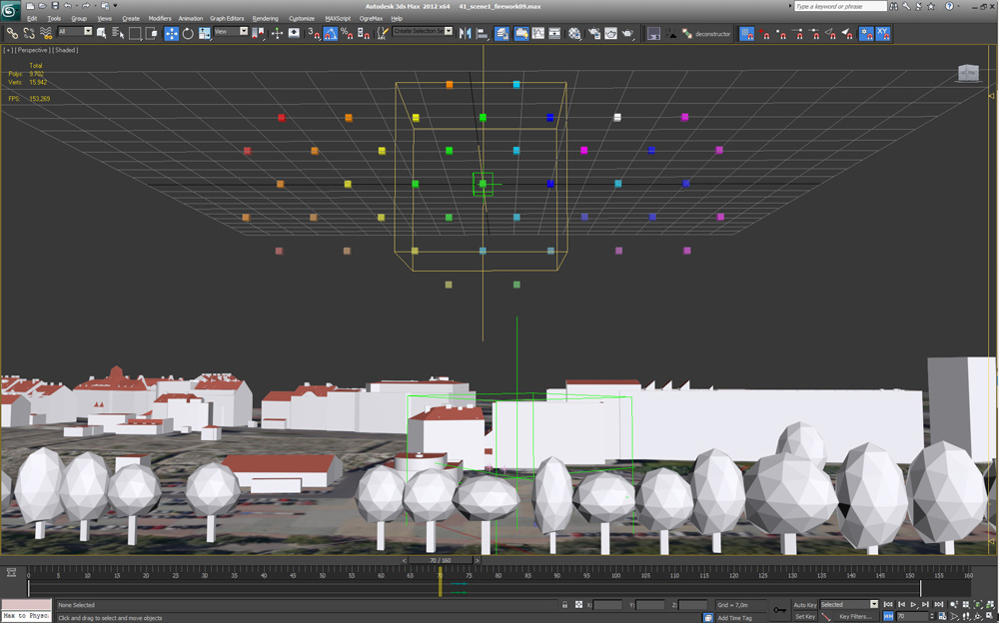
ARS ELECTRONICA 2012 奧地利電子藝術節
Spaxels / Klangwolke - Quadrocopter
THE OPEN CLOUD PROJECT – The opening of THE BIG PICTURE
BACKGROUND

Slide 10
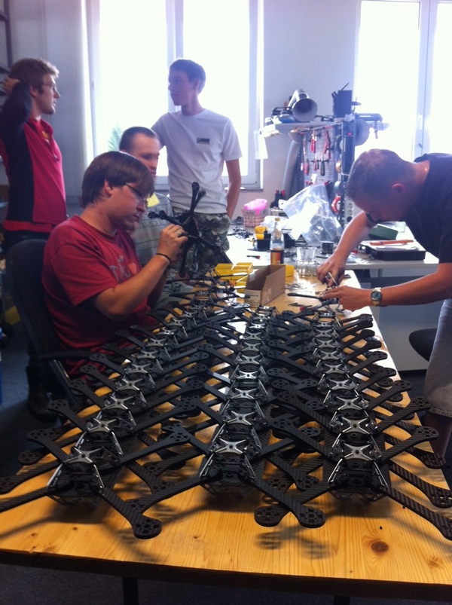
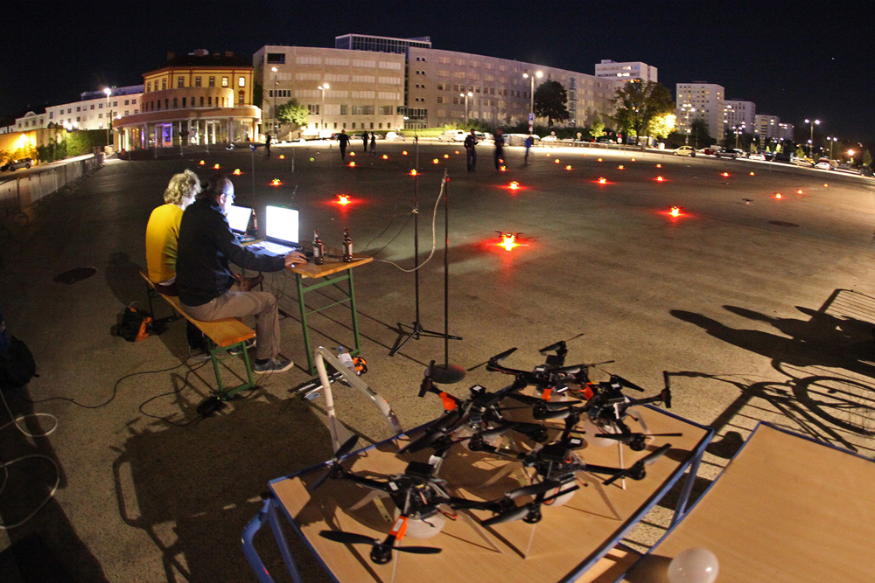
ARS ELECTRONICA 2012 奧地利電子藝術節
THE OPEN CLOUD PROJECT – The opening of THE BIG PICTURE
BACKGROUND

Slide 11
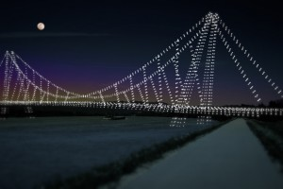
ARS ELECTRONICA 2012 奧地利電子藝術節
THE OPEN CLOUD PROJECT – The opening of THE BIG PICTURE
Future development
BACKGROUND

Slide 12
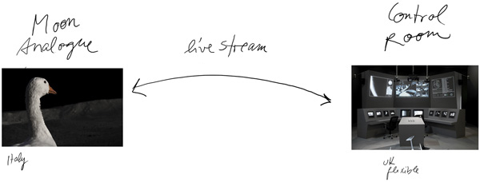
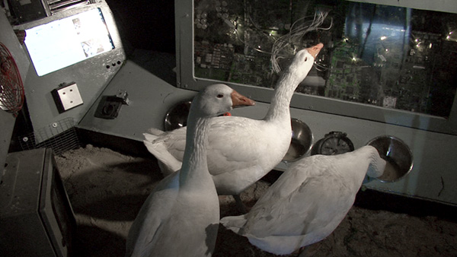
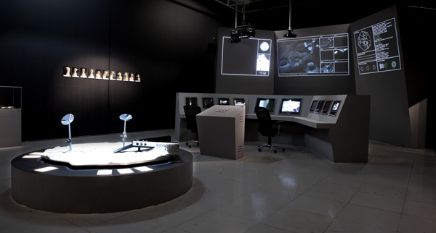
ARS ELECTRONICA 2012 奧地利電子藝術節
THE MOON GOOSE ANALOGUE: Lunar Migration Bird Facility
BACKGROUND

Slide 13
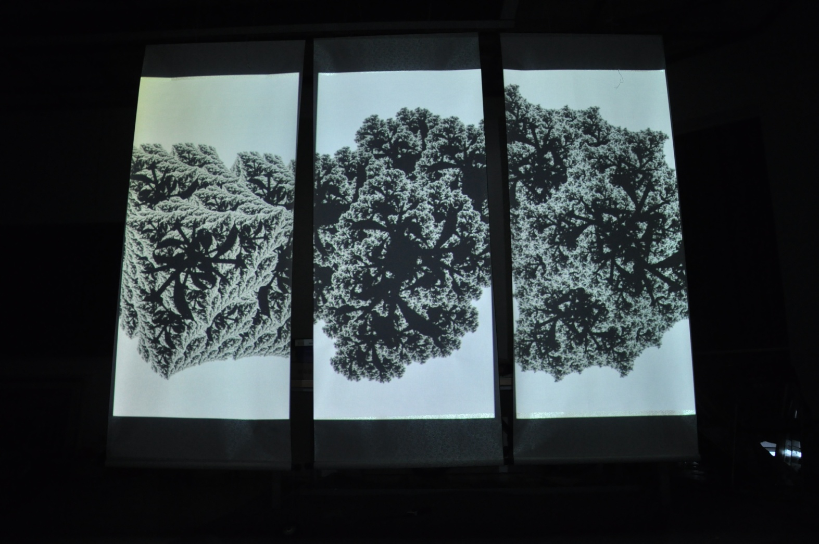
ARS ELECTRONICA 2012 奧地利電子藝術節
INSIDE FUTURELAB: Wang Zhipeng – “Eternity”
BACKGROUND

Slide 14
BIG DATA
GLOBAL BRAIN
INFORMATION VISUALIZATION
BIG PICTURE
MAPPING KNOWLEDGE
MAPPING SPECIES
MAPPING SOCIAL RELATIONSHIPS
MAPPING THE BRAIN
MAPPING THE INTERNET
KEYWORD

Slide 15
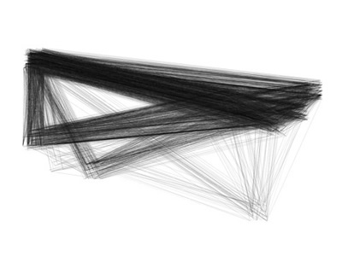
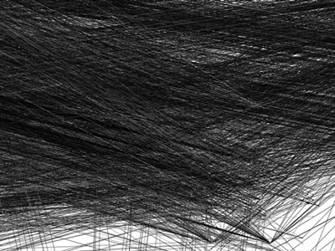
Visual
Complexity
Visualization of iTunes Libraries
Author: Caleb Larsen 2006
CONNECTION

Slide 16
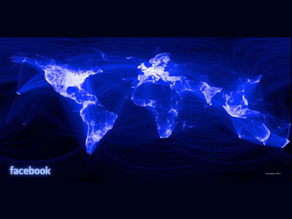
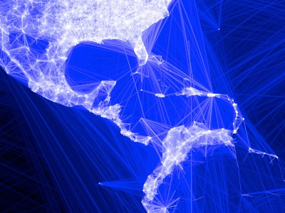
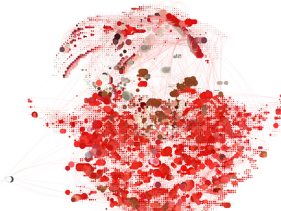
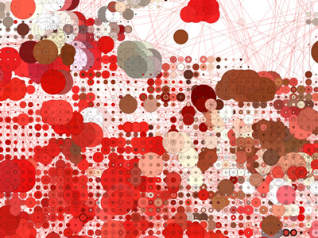
Visual
Complexity
Mapping
Facebook Friendships
Author: Paul Butler 2010
CONNECTION

Slide 17
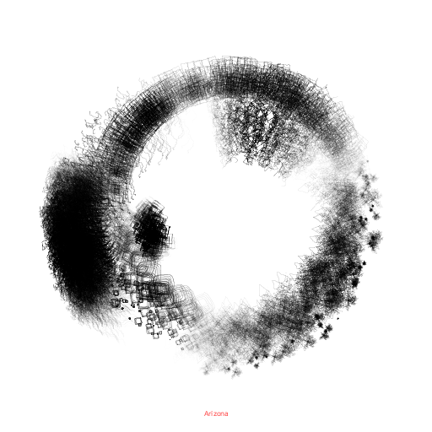
Out of Statistics : Beyond Legal
Arizona
CONNECTION

Slide 18
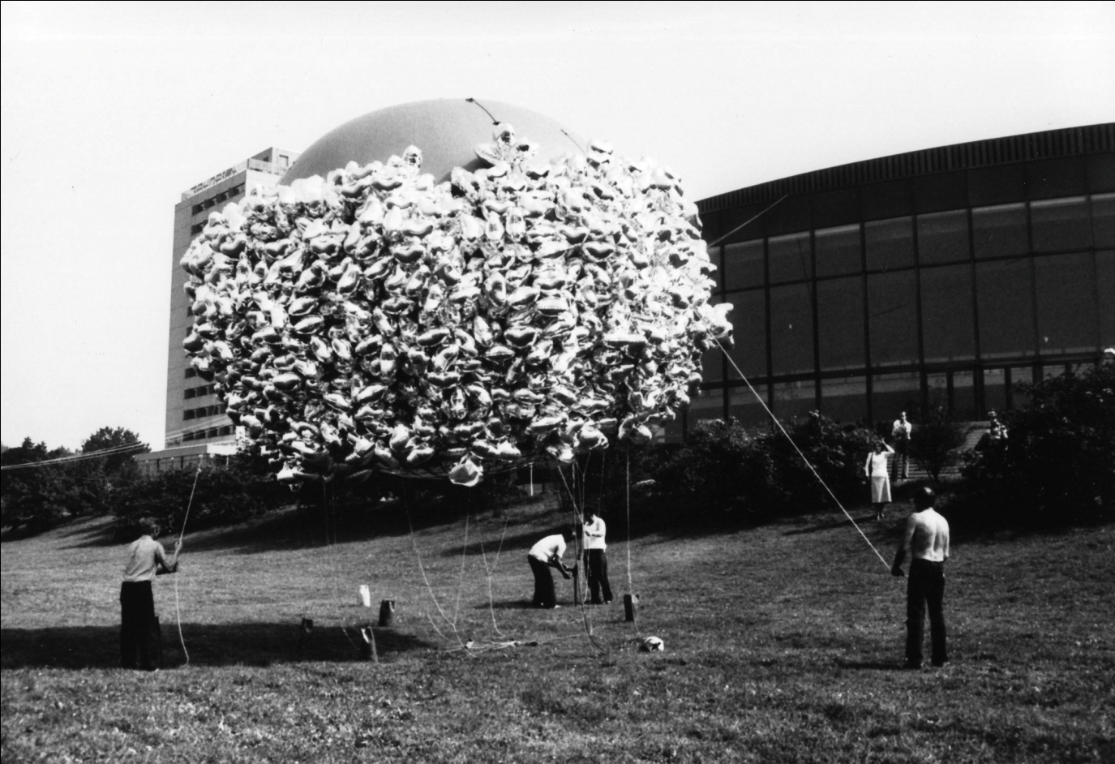
The Linzer Klangwolke (Linz Cloud of Sound)
Foto 1979 © PeterPeter, Linzer Klangwolke, 18.9.1979, Musik: Anton Bruckner: Symphonie Nr. 8 c-Moll, Dirigent: Bernard Haitink, Orchester: Concertgebouw Orchester Amsterdam, Visualisierung: Walter Haupt, Besucher im Donaupark: 100.000
CONNECTION

Slide 19
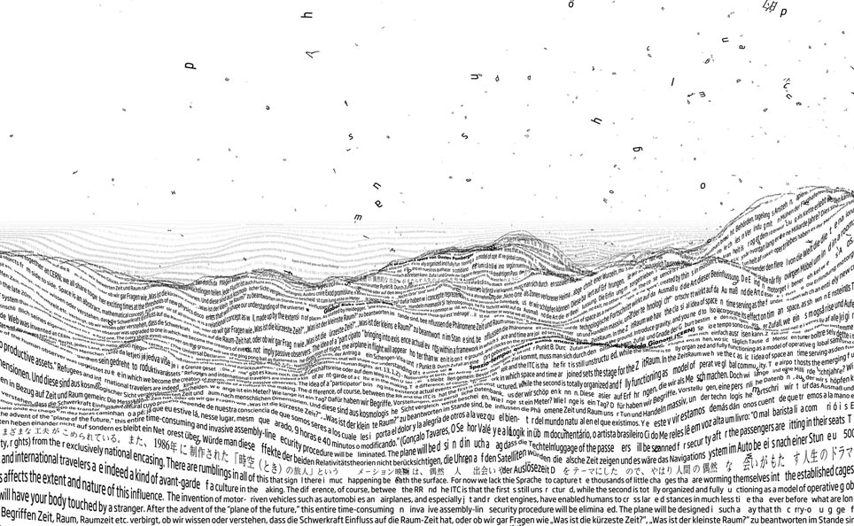
ARS ELECTRONICA FUTURELAB
ZeitRaum
TimeSpace
http://www.aec.at/press/en/2012/06/05/%E2%80%9Ezeitraum%E2%80%9C-am-neuen-terminal-des-flughafen-wien/

Slide 20
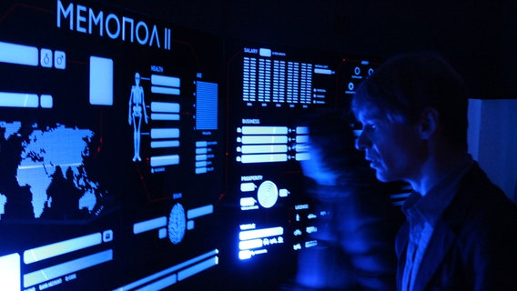
Prix Ars Electronica Interactive Art
Timo Toots – Memopol-2 / Golden Nica
http://works.timo.ee/memopol/

Slide 21
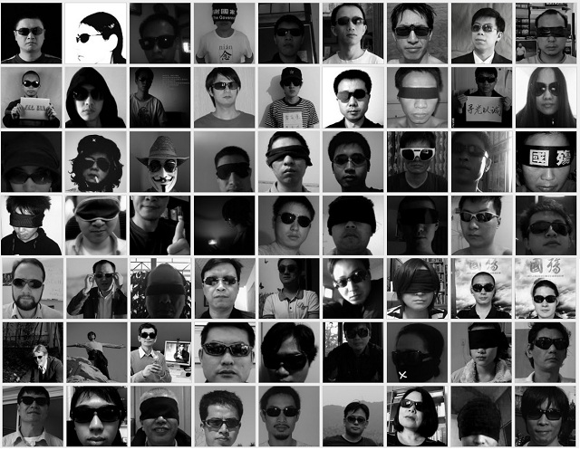
Prix Ars Electronica Digital Communities
Dark Glasses.Portrait / Award of Distinction
http://www.youtube.com/watch?v=DS9Kv6EUqdw

Slide 22
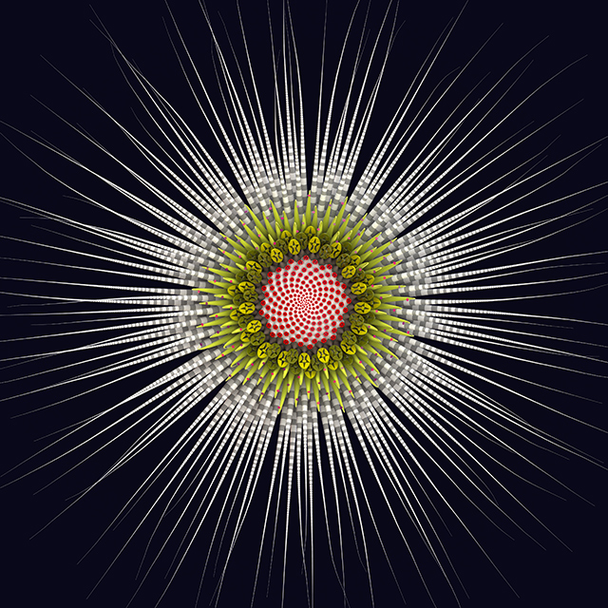
Fifty Sisters
Jon McCormack
http://diotima.infotech.monash.edu.au/~jonmc/sa/artworks/fifty-sisters/
CONNECTION

Slide 23
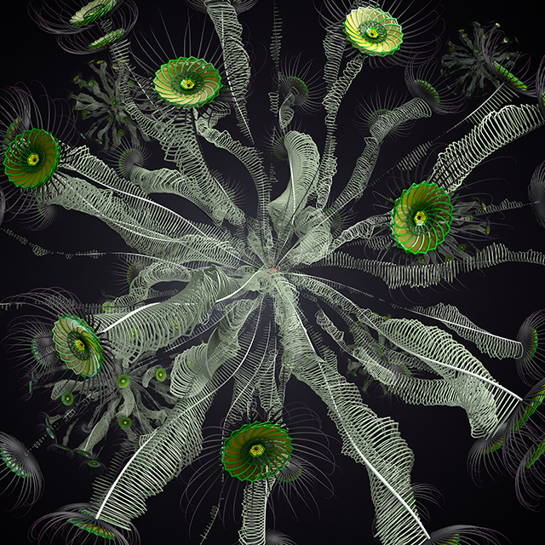
Fifty Sisters
Jon McCormack
CONNECTION

Slide 24
ppt後面連結網站:

